Slide 1
Green Politics
Cllr Jonathan Elmer - Field Organiser for the Green Party, North east and East Midland Regions
Jonathan.elmer@GreenParty.org.uk
Cllr Amanda Hopgood - Leader of the LibDem Group on Durham County Council
amanda.hopgood@durham.gov.uk

Slide 2
Structure
Amanda and Jonathan will present a challenge
In groups, you will choose 1 aspect of the challenge and consider:
Where we need to be
Barriers to progress
Solutions - how can politics / politicians help?
We will review ideas from around the room
We will repeat in relation to a different challenge
Finally - groups will identify their best idea

Slide 3
Climate Change
Global Perspective - JE
Pollution/emissions still rising!
Projected Impacts
Oil / Coal / Gas / Unconventional
Local Action- AH
Transport
Household
Industry

Slide 4
Natural Environment
Global Perspective
Anthropocene – and the 6th great extinction
We depend on ecosystems for our survival
Oceanic eutrophication and acidification, deforestation, over fishing, climate change, habitat fragmentation, intensive agriculture
Local Action
Coastlines
Nature Areas
Parkland
Rivers

Slide 5
Protection and Enforcement
Global Perspective
Agreements / conventions between nations – often brokered by the UN E.g.
Kyoto / Parris Climate Agreements
UNESCO World Heritage Sites, RAMSAR Sites
Enforcement a state responsibility
European Legislation – currently enforced by European Commission and European Court of Justice
Local Action
Planning
Littering
Tree protection

Slide 6
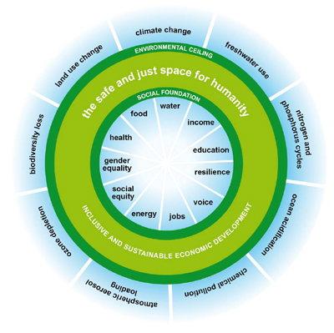
Economy
What is economic growth?
The doughnut economy…….
9 Planetary Boundaries
11 top social priorities (economic measures)
Potential environmental tipping points
The goldilocks zone
Unacceptable social degradation

Slide 7
Summary
Could each group present its preferred solution

Slide 8
Huge thanks from Jonathan and Amanda

