Slide 1
Green Economics
Cllr Jonathan Elmer
Field Organiser for the Green Party, North east and East Midland Regions
Jonathan.elmer@GreenParty.org.uk

Slide 2
Structure
Overview of global economics
What does a Green Economy look like?
Measuring Success
Group work
Summary and Key Points

Slide 3
Green Party Core Value
The Earth's physical resources are finite. We threaten our future if we try to live beyond those means, so we must build a sustainable society that guarantees our long-term future.

Slide 4
Green Party Core Value
The success of a society cannot be measured by narrow economic indicators, but should take account of factors affecting the quality of life for all people: personal freedom, social equity, health, happiness and human fulfilment.

Slide 5
What greens think
“Conventional economic policies are destroying the very foundations of the wellbeing of humans and other animals”.
“Our culture is in the grip of a value system and a way of understanding the world which is fundamentally flawed”.
“Some nations have become very rich and yet within them there is still abject poverty. Meanwhile, the poor nations of the world are exploited as wealth continues to be transferred to the rich nations from the poor ones”.
“If humans continue to promote policies which require the unlimited consumption of raw materials, it will lead not to more riches, even for the few, but poverty for all”.

Slide 6
What happens now?
We want to buy the latest and best even if what we have works just fine
When we’ve finished with it, it goes in the bin
Low levels of recycling
Markets for recycled materials struggle as its often cheaper to use virgin resources

Slide 7
What would a green economy look like?
Use of finite resources would be very more expensive than use of recycled resources through establishment of their Real Value
Real value would factor:
the contribution a resource makes to a natural system
the consequences to future society of not having access to a resource
(mineral, organic, hydrocarbon, the atmosphere, land, soil, water)
Use of finite resources and generation of waste would drop / disappear
Incentive re-use, repair, recycle existing products
Notes:
Supply and demand dictates resource value, but this can be adjusted E.g. Carbon Tax / Quotas

Slide 8
Resources would be captured and circulated within the production cycle
Manufacture
Virgin resources in
Recycle
Use
Waste Out

Slide 9
Measuring Success It’s all about Growth!
Economic growth is an increase in the production of goods and services over a specific period.
This measure is used by all major UK parties as the primary indicator of national wellbeing.
And it sounds SO positive!
But what doesn’t it measure? And where does it provide a false positive? (E.g. Health Service)

Slide 10
Group Work - Develop and Present and Example Identify something that is good for society but reflects as neutral or negative to economic growth

Slide 11
Examples
Few car crashes would reduce business for insurance companies and motor repair work
Better health would result in lower need for private medical insurance
Reduced carbon emissions would decrease sales of fossil fuels
Conservation of oceanic macro-fauna would reduce seafood sales
Keeping a car on the road for longer would reduce car sales
All of these positive things would register as decreased Economic Growrth!

Slide 12
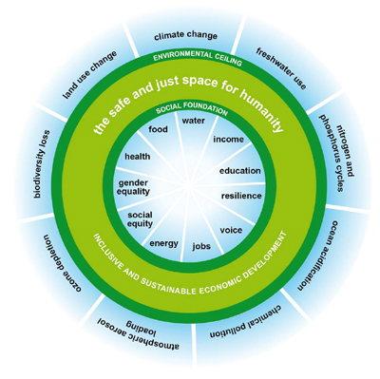
The Doughnut Economy
9 Planetary Boundaries
11 top social priorities (economic measures)
Potential environmental tipping points
The goldilocks zone
Unacceptable social degradation

Slide 13
Key Points
A green economy doesn’t require abandonment of Supply and Demand as a fundamental means of establishing value
The health of the economy should not be measured by ‘growth’ – this measure only benefits those with wealth to invest - a small percentage of global society
We have to move towards a Steady State economy as we have one planet with finite resources

Slide 14
Huge thanks from Cllr Jonathan Elmer

