Slide 1

FOOD DURHAM: an introduction
The County Durham Food Partnership
Dr Liz Charles

Slide 2








Slide 3
Purpose
“To work together for a more equitable, sustainable, fairer food system for County Durham providing access to food that is healthy for people and the planet.”
Food System Change!
“Greener, Fairer, Healthier”

Slide 4
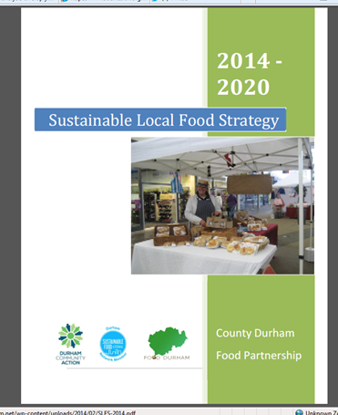

Slide 5
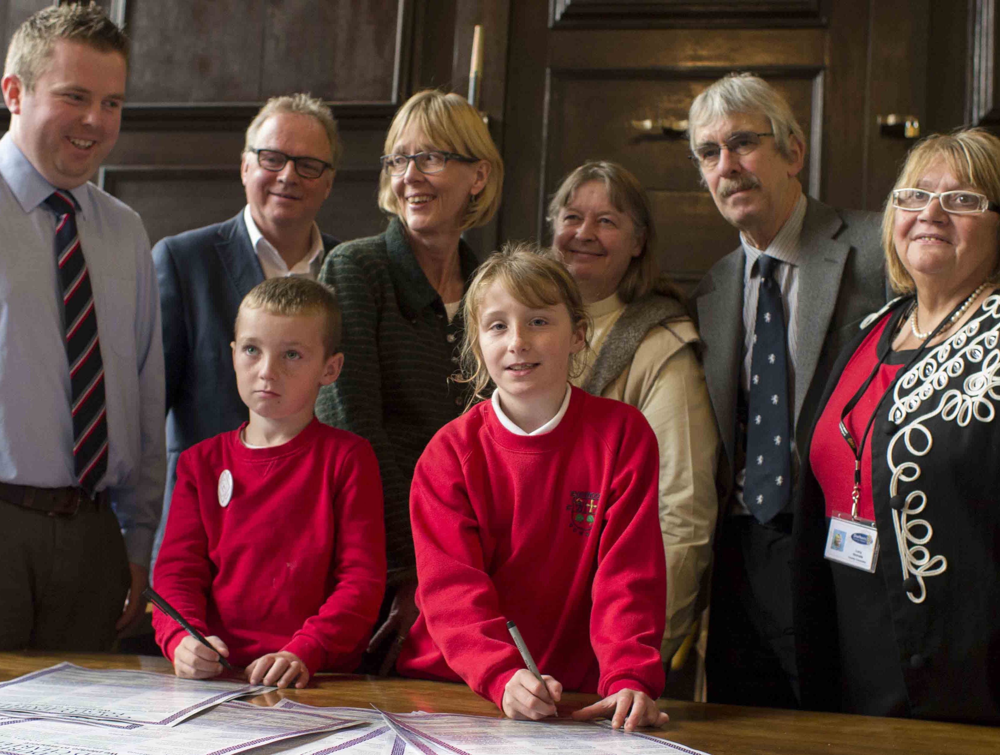
Food Charter
Launched at Durham City Town Hall 2013

Slide 6
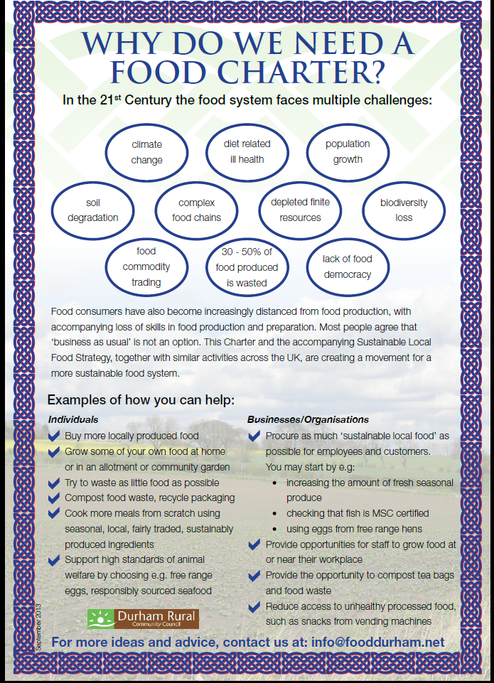

Slide 7
Activities
Public Sector Procurement
Food and Health
Community Growing
Supporting local food businesses
Responding to consultations
Running Campaigns

Slide 8
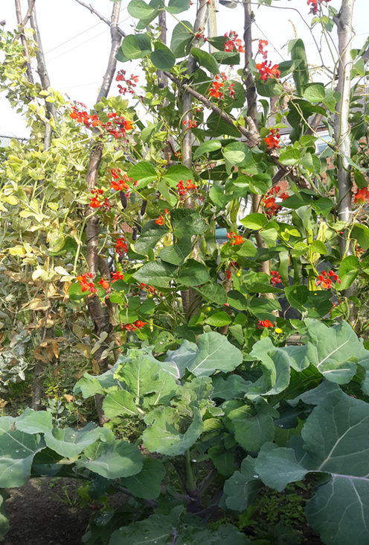
Example 1: Growing Durham
Vision
To create a network of new and diverse community growing schemes across County Durham
More communities will produce some of their own food
Access to fresh food will be improved in areas where this is a challenge
More people will have the opportunity to participate in and benefit from food production

Slide 9
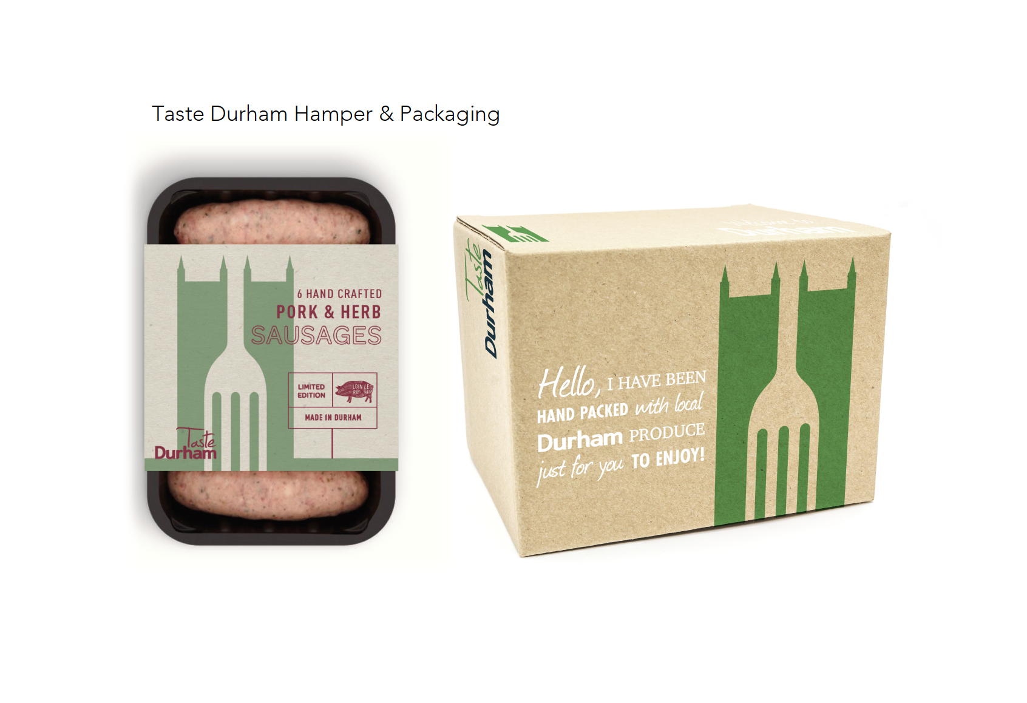
Example 2: Durham Food Hub
Building a platform for a more efficient local food supply chain
Business to Business brokerage – a ‘virtual hub’
Specialised expert Business support to SMEs
Eg Hotel Indigo, Welcome Packs

Slide 10
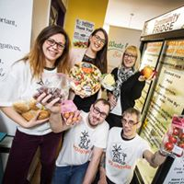

Example 3: Waste Less, Save More
3 Community Fridges
Launch of Olio app
Household food waste challenge
3 Feed the 1,000 events
Coordinated by DCC Strategic Waste Management
Delivered by DCC & REfUSE

Slide 11
Contact details
liz.charles@durhamcommunityaction.org.uk
01388 742044
@Food_Durham
https://www.facebook.com/GrowingDurham?fref=ts
Coming soon! New website
http://fooddurham.net/

