Slide 1
Climate Conversations: how can we break the silence?
Edited slides from presentation and workshop for
Footprint Conference
University of Durham
16.06.18
Nick Nuttgens School of English University of Sheffield
Tim Allen
Nick Nuttgens
Carbon Neutral University University of Sheffield

Slide 2
Aims of workshop
Share with you our on-going enquiry project on ‘how to hold climate conversations’ and learn from your feedback
Share some ideas and exercises derived from the work of George Marshall, Carbon Conversations and others
Inspire you to go away and have climate conversations, and, if you wish, report back to us.

Slide 3
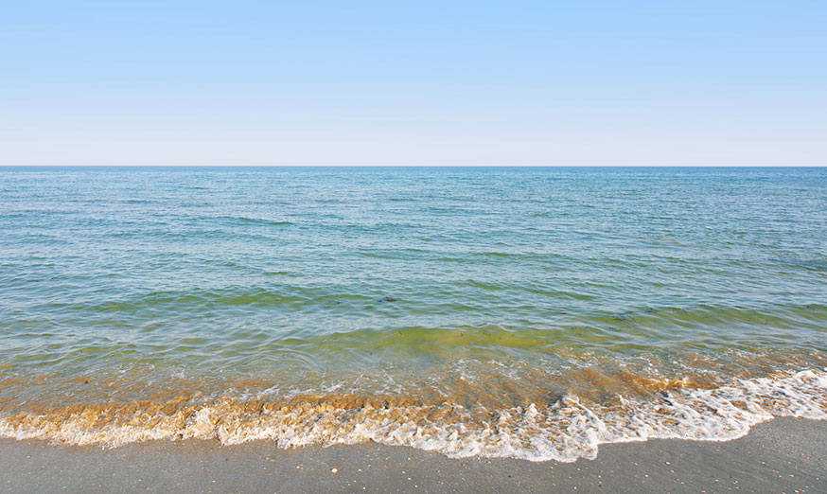
Royal Society for the Arts: A New Agenda on Climate Change Jonathan Rowson 2013
Only 60 percent of a representative sample of the UK population had ever spoken about climate change.
Of those, 71 percent had spoken for less than ten minutes;
43 percent for less than 5 minutes.

Slide 4
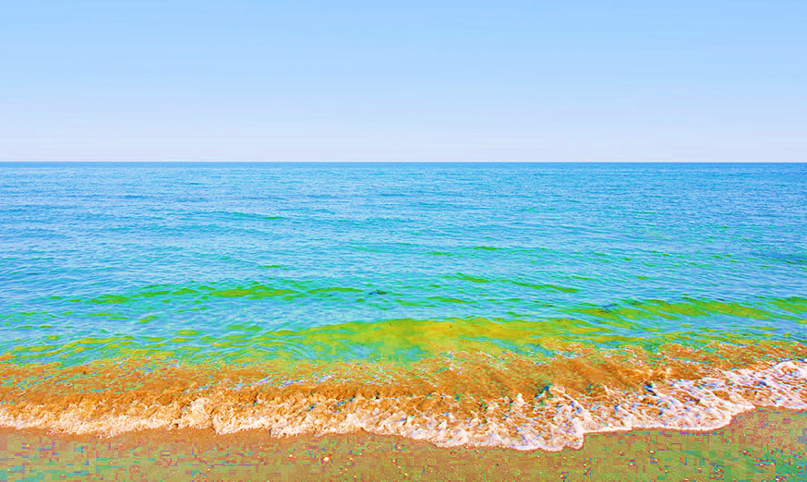
Royal Society for the Arts: A New Agenda on Climate Change Jonathan Rowson 2013
Only a fifth of the population (19.6 percent) were ‘unconvinced’ about the reality of anthropogenic climate change (‘deniers’ or ‘sceptics’)
BUT
the majority of the population (63.9 percent) were ‘unmoved’ i.e. they did not accept the full implications WHY?
Notes:
I’m focusing on the latter for now – more influential….

Slide 5
Climate change is a ‘wicked’ problem:
Huge
Complex
Slow moving
Invisible
International
Intergenerational
Challenges our way of life
Marshall, George. (2014) “Don’t Even Think About It.”

Slide 6
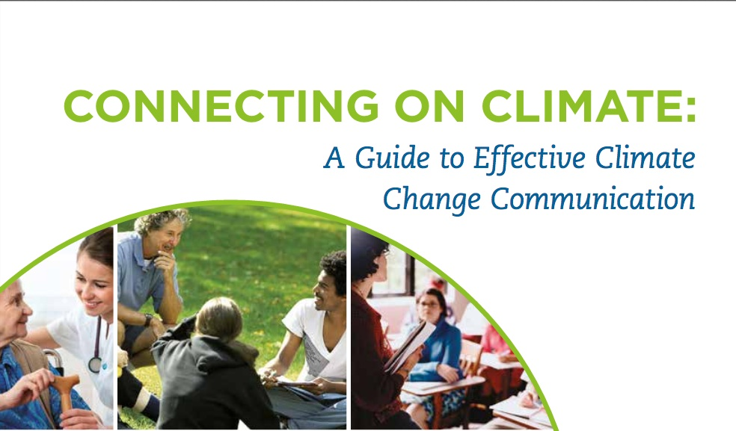
Put Yourself in Your Audience’s Shoes - align your climate messages with:
their world view
their values: what is important to them in their lives
issues that matter to them
Lead with Solutions and Benefits
Highlight the benefits and co-benefits of taking action
Emphasise local and immediate solutions as well as long term ones
Show how they can become part of the solution
Notes:
http://ecoamerica.org/wp-content/uploads/2014/12/ecoAmerica-CRED-2014-Connecting-on-Climate.pdf

Slide 7
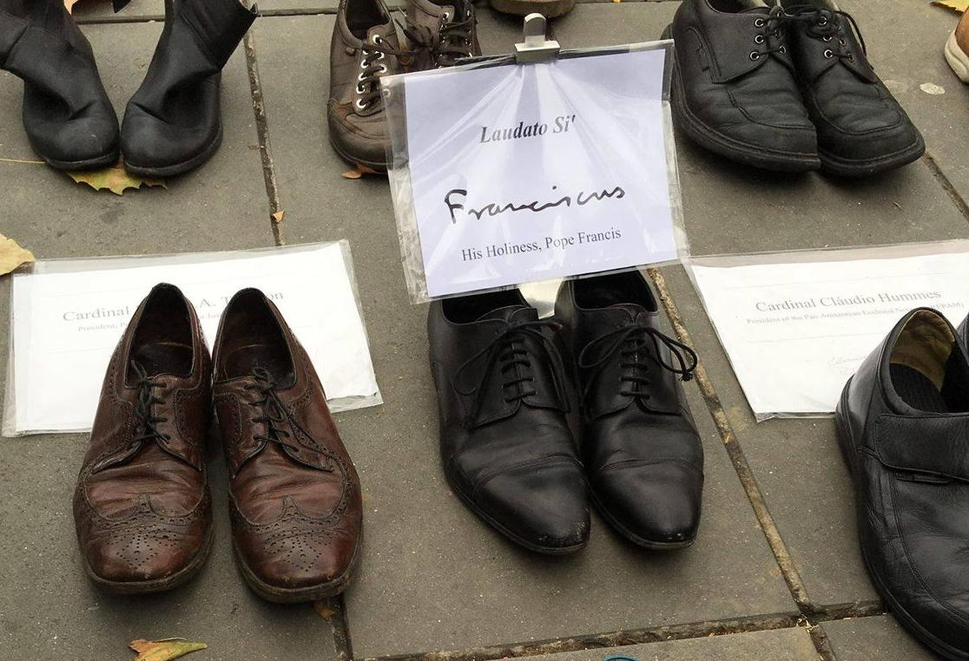
To put yourself in somebody else’s shoes, you need to understand their values.
Tell your neighbour what brought you here today. Why does climate change matter to you?

Slide 8
Approach: one day’s training for every citizen
Notes:
http://www.carbonliteracy.com/

Slide 9
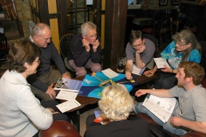
Approach: 6 meetings in a small group
Notes:
http://www.carbonconversations.co.uk/

Slide 10
Back to basics – 121 conversations with family, friends, colleagues, fellow activists…
Some principles from all the above that we are exploring:
Listen! Search for common ground.
Start from people’s values - what is important to them.
Make climate change about the here and now – and relevant to the person.
Acknowledge the difficult choices people might have to make. e.g. “I agree that’s a really big problem. What do you think could be done about it?”
Look to a positive future: “How would you like the world to be in 30 years’ time?” (The Sustainable Development Goals are a useful tool.)
‘Lungs’ by Duncan Macmillan (2011)

Slide 11
Practise session in 3’s
Each think about a real person you could have a climate conversation with. No need to name names.
Decide who’s going first.
Tell your partners about your person and what matters to them (their values). Tell them how you think they will react to talking about climate change, what their attitudes and arguments will be.
Look at the cue card for ideas.
Practise the conversation.
Third person observes, keeps an eye on the cue card, makes suggestions if needed, and gives feedback afterwards on what seemed to work well.

Slide 12
Climate Conversation Cue Card
Beginning – listen, acknowledge the challenges
Climate change – where are you at with it?
In your workplace / friendship circles, is this talked about? If not much, why do you think that is?
Middle – solutions & what inspires them?
Let’s talk about positive changes you’ve made in your own life, or seen… What are you most proud of / excited to try?
Let’s talk about bigger solutions. What would you like to see change in the world over the next few years?
End – common ground & next steps together
How do you think we could work together to bring about the changes you want to see, in a way that also combats climate change?
Where next after this conversation? Could you introduce me to a friend or colleague for a similar conversation? Or, would you be willing to have one yourself & report back?

Slide 13
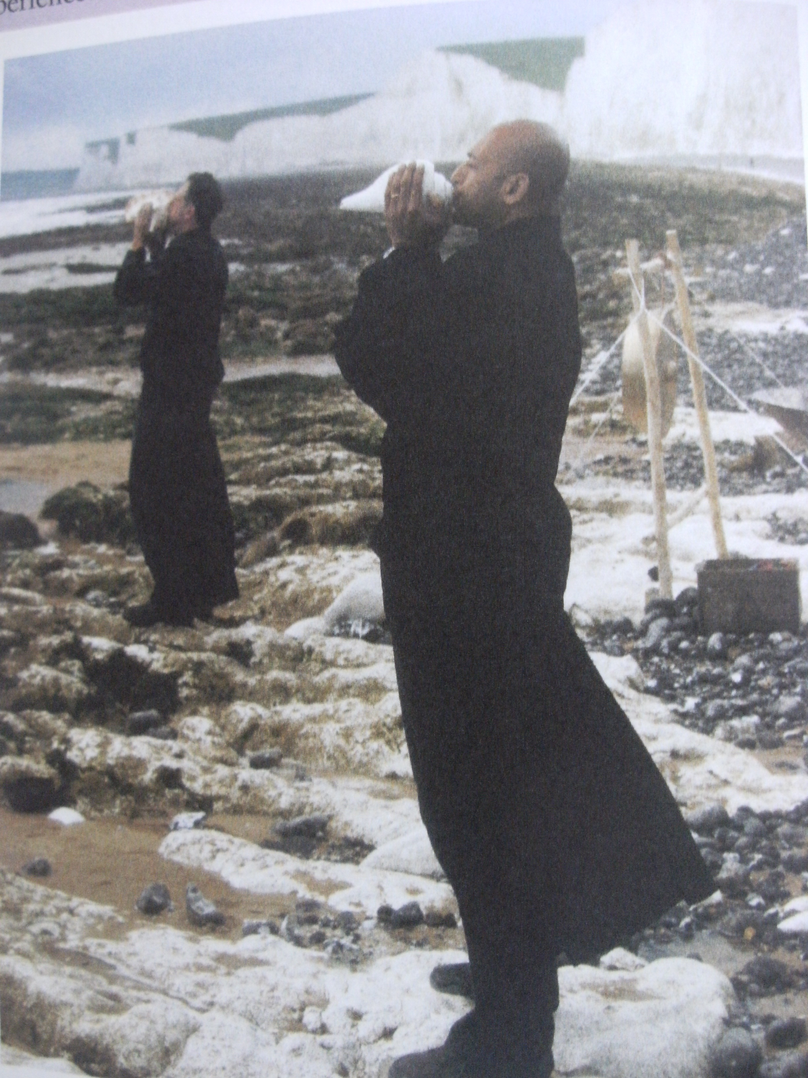
Please contact us to share your experiences of holding climate conversations. What are the challenges? What helps? njnuttgens1 @sheffield.ac.uk t.r.allen@sheffield.ac.uk

